Slide 1
Practical, transparent operating system support for superpages
Alejandro Hidalgo García 000123142
Notes:
Reservation allocation
VM reserves area contiguous in physical memory when vobject is to be maped iff the object is at least of superpage sized

Slide 2
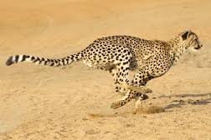
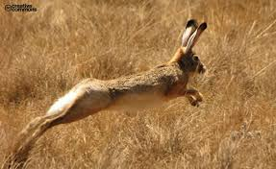
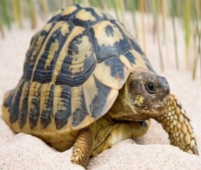
Brief Introduction to Memory Management
Trade offs between space and time : we want more space at a relative low access time -and low cost-
Memory hierarchy tries to solve the compromise between big memory, low memory access time and low per unit cost
Ram’s size 4gb or 8gb Virutal memory’s size 1Tera (250 times larger)
Secondary
Mem
Main Mem
CPU
Cache

Slide 3
Paging
What is the paging method ?
What does it tries to optimize?
Are there any drawbacks?
How can they be corrected?
3
L.A.
P.A.
2nd Mem
P2
D3
F3
D3
MM
Page1
Page1
0
Occupied
Process1
CPU
Page2
Page2
Page3
Occupied
TLB
Page3
1
P1
F1
PT
P2
F3
P3
F4
PT
2
F1
F3
F4
Notes:
P := page index , F := frame index , D := instruction offset
The method tries to handle external fragmentation (when there is enough space on MM to save the desired process but it cannot be done because the space isn’t contiguous)
The method separates processes on the secondary memory into pages (called frames in the main mem) so that each page can be assigned on any frame (given it has at least the same size).
Paging is a Non contiguous memory allocation technique fixed size partitioning scheme
The method avoids contiguity restrictions but a PT (page table) must be created for every process on MM . The PT will relate the L.A. (logical address) emitted by the cpu to the P.A. (physical address)
The PTA tables are stored in MM ; the TLB is a hardware device (normally its store policy is full associative)

Slide 4
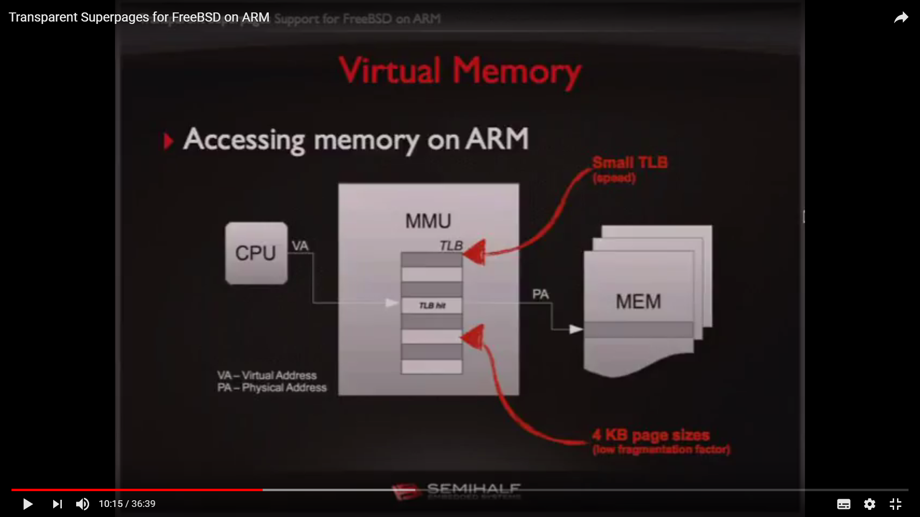
The problem of Paging: TLB Misses
TLB’s need to be fast thus it must remain small
Hit rate must be high so as to impede overhead to overset the benefits of the TLB implementation
Since TLB can only hold a process at a time it can generate overhead if there are a lot of changes of context
Notes:
Drawbacks of the paging method
They need to remain small beause the more entrys the more logical require higher power of consumption and lower speed
TLB ::: Managed only by O.S??
Despite aquitecture suports superpages normaly only one is use because is easier to control the fragmentation when our allocation base unit is small rather than a big one
Since tlb can only hold a process at a time in can generate a lot of overhead when frequently making changes of context
When a miss ocurrs 2 memory access must be done (plus the tlb access) this actually makes expencier the hit miss situation w.r.t the non tlb enviroment. (so hit rate must be high)

Slide 5
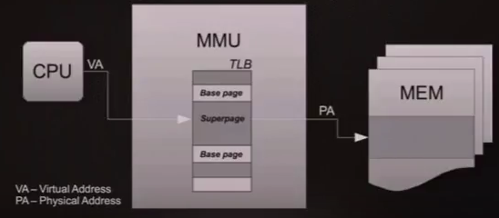
Possible solutions
Increase TLB? This will make it slower
Use Bigger Pages? Bigger pages imply higher fragmentation risks
Authors Strategy : Superpages implement a dynamical size pages handler aware of contiguous regions
Superpages:

Slide 6
Hardware Constraints :
Page size must be among a set of pages supported by the processor
Contiguous requirement for superpages (both on physical and virtual mem)
The starting address of a super page must be a multiple of its size
For every superpage there’s only a single dirty bit of reference
Notes:
Reservation allocation
VM reserves area contiguous in physical memory when vobject is to be maped iff the object is at least of superpage sized
The

Slide 7
Allocation Schemes:
Relocation VS Reservation
O.S. copies partitions (when creating a superpage becomes optimal) so that page frames end up in a contiguous memory space
Trade offs between access time and memory fragmentation
Robust to fragmentation slow when reallocating
Superpage aware allocation decisions are made at page default time
On each allocation some policy is used to decided optimal size for allocation and a contiguous region (in physical memory) is sized
Less robust to fragmentation ; quicker
Notes:
Explain the

Slide 8
The Paper
Notes:
Reservation allocation
VM reserves area contiguous in physical memory when vobject is to be maped iff the object is at least of superpage sized

Slide 9
Overview
Objective Improve TLB Coverage
Method :Their design is a reservation based scheme that treats contiguity as a potentially contended resource
The new capabilities it presents are:
Support for multiple superpages sizes
Scalability to very large superpages
Demotion of sparsely referenced superpages
Effective preservation of contiguity
Notes:
Reservation allocation
VM reserves area contiguous in physical memory when vobject is to be maped iff the object is at least of superpage sized

Slide 10
Features of the model
Notes:
Reservation allocation
VM reserves area contiguous in physical memory when vobject is to be maped iff the object is at least of superpage sized

Slide 11
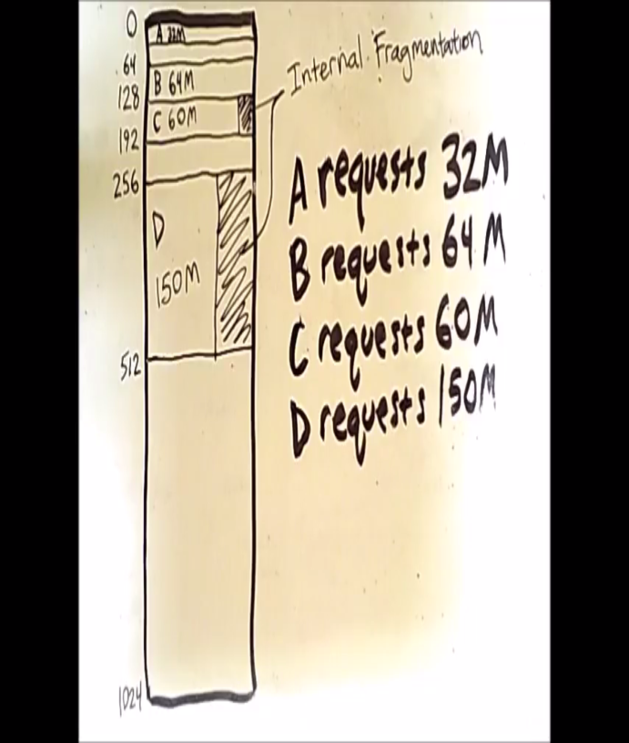
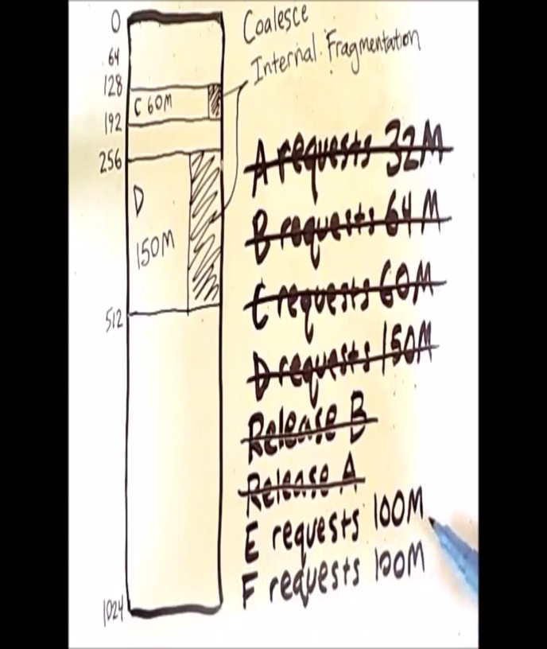

Fragmentation Control for the Reservation allocation schemes
Buddy Allocator
Whenever possible performs coalescing of available memory regions (seeks contiguity)
Aware page replacement daemon
Under persistent memory pressure the daemon performs contiguity aware page replacement
Replace!
Notes:
Reservation allocation
VM reserves area contiguous in physical memory when vobject is to be maped iff the object is at least of superpage sized

Slide 12
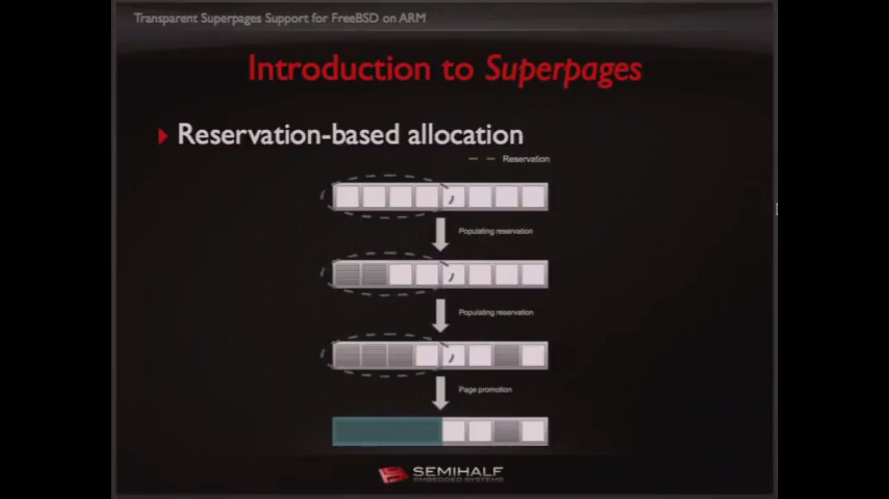
Preempting Reservations
Superpage Size Policy
The system ability to preempt frames that are reserved but have not been yet used
Objective: If possible preempt existing reservations so as to make room to the new allocation (with the desired size)
Since if the chosen superpage size turns out to be too large the decision will be later override by preempting the initial reservation, the policy is to choose the maximum superpage size that can be effectively use in a mapping object
Paging Out Dirty Superpages
If a dirty superpage needs to be written to disk it must write out the entire superpage, for large enough superpages this can be a problem
Solution : demote clean superpages under write attempt re-promote later if all base pages have been written
Notes:
Author recomends to promote read only files and demote them under

Slide 13
Speculative Demotion
Incremental Promotion
The system periodically demote active superpages speculatively in order to determine if the superpage is still been used in its entirety
When the page daemon selects a page from a superpage to evict it causes a demotion (split) of the superpage
The system for promoting pages into superpages is incremental because:
As soon as reservation is fully populated a superpage is created
Since there are different sizes of superpages as soon as the latter becomes more an more populated (and achieve the next required population level) it’s promoted to the next level
Notes:
Cuando se requier eliminar una pagina dentro de una sp no se necesita eliminarla toda basta con depromoverla interativamente hasta llegar a la pagina deseada

Slide 14
Multi-List Reservation Scheme
Population Map
The population maps help to keep track of allocated base pages on each memory object; they help promotion & demotion decisions
There are as many reservation lists as they are different sizes of superpages
They keep track of reserved frame extents that are not yet populated
Notes:
Cuando se requier eliminar una pagina dentro de una sp no se necesita eliminarla toda basta con depromoverla interativamente hasta llegar a la pagina deseada

Slide 15
Implementation
Notes:
Reservation allocation
VM reserves area contiguous in physical memory when vobject is to be maped iff the object is at least of superpage sized

Slide 16

Contiguity Aware Page Daemon
The page daemon is not only activated by memory pressure but also for a criterion of low contiguity**
OBJECTIVES
Wired Page Clustering
Pages that cannot be evicted are called wired pages
This pages are clustered to prevent them from scattering (thus creating unnecessary fragmentation)
Notes:
*the failure to allocate a contiguous region of the preferred size

Slide 17
Stress Tests
Notes:
Reservation allocation
VM reserves area contiguous in physical memory when vobject is to be maped iff the object is at least of superpage sized

Slide 18
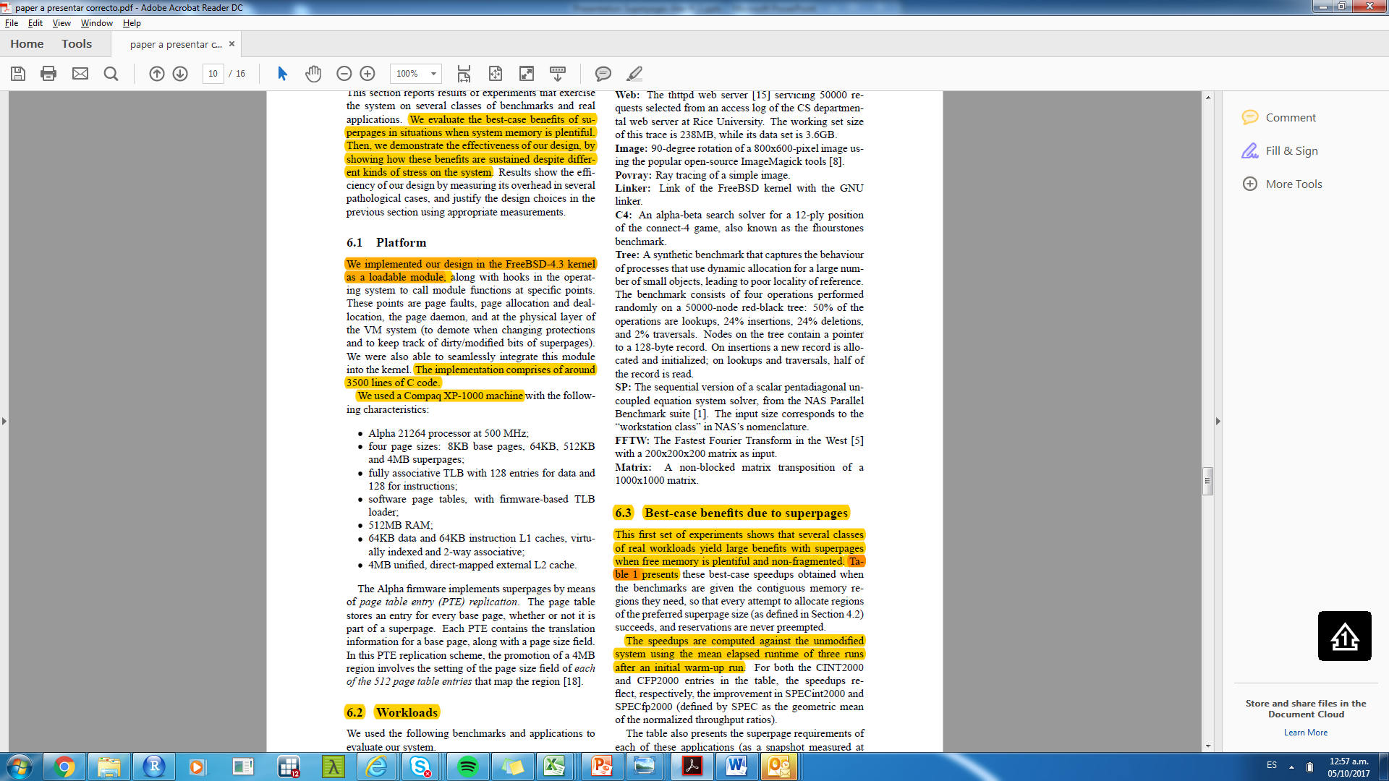
How was implemented? On what was tested?
They measure the best case-benefits of SP without fragmentation as a benchmark; then they measure the benefits under different kinds of stress to the system
The model was implemented on C
It was run on a Compaq XP -1000 machine with the following characteristics
OBJECTIVES
It was tested against a variety of applications from web server applications to image processing or numerical optimization applications.
Notes:
Cuando se requier eliminar una pagina dentro de una sp no se necesita eliminarla toda basta con depromoverla interativamente hasta llegar a la pagina deseada

Slide 19
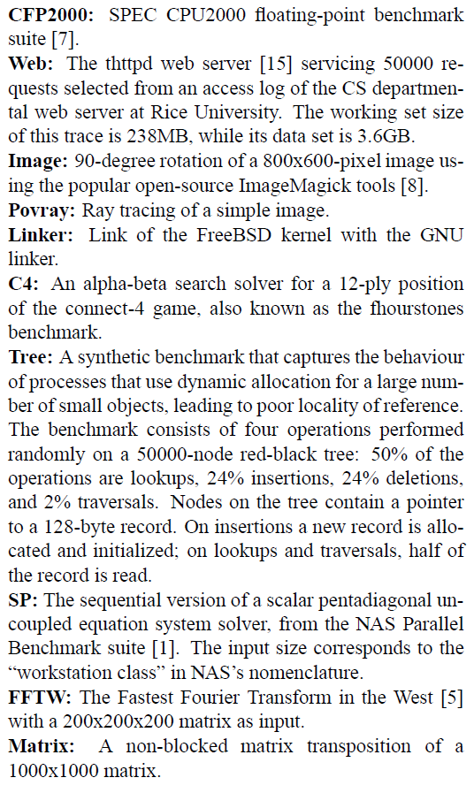
List of applications
Notes:
Cuando se requier eliminar una pagina dentro de una sp no se necesita eliminarla toda basta con depromoverla interativamente hasta llegar a la pagina deseada

Slide 20
Results
Notes:
Reservation allocation
VM reserves area contiguous in physical memory when vobject is to be maped iff the object is at least of superpage sized

Slide 21
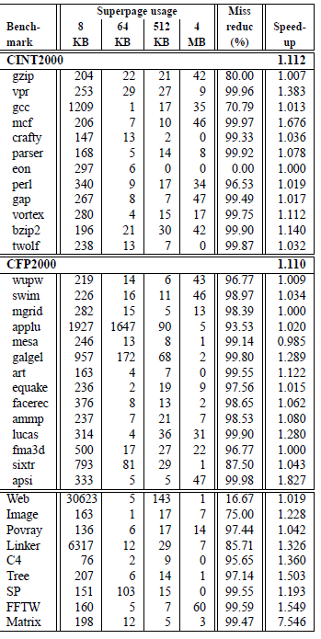
Best Case Benefits Results: Multiple SP Size
They measure the best case-benefits of SP
They conclude that under these conditions TLB misses where greatly reduced
All but one of the workloads (mesa) showed benefits due to superpages
Their benefits ranged from 5% to over 25%
OBJECTIVES
Notes:
Cuando la memoria esta vacia y no fragmentada es este caso

Slide 22
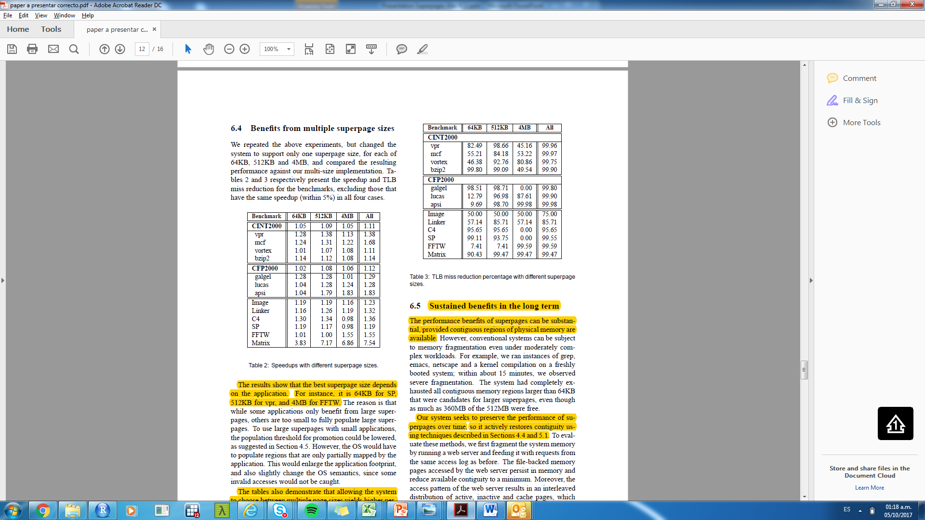
Best Case Benefits Results: Single SP Size
The same experiment as above but with just one size of superpage
Results & Conclusions :
The best SP size depends on the application
Allowing the system to choose between multiple page sizes yields higher performance
The system dynamically selects the best sizes for every region in the memory
OBJECTIVES
Notes:
Cuando la memoria esta vacia y no fragmentada es este caso

Slide 23
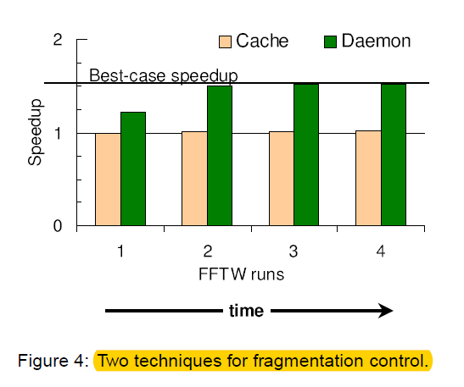
Non ideal Trials: cache vs daemon schemes
For this trials memory was fragmented as hard as possible, then an application was run and contiguity restoral was observed
The goal was to see how quickly system recovers just enough contiguous memory to build superpages performed efficiently
Two schemes consider were cache scheme & page aware daemon
Under page aware daemon scheme the performance reaches near optimum within two run (i.e. speed up 55%)
OBJECTIVES
Notes:
Cuando la memoria esta vacia y no fragmentada es este caso

Slide 24
Non ideal Trials: Concurrent execution
For this trials the server was run concurrently with a contiguity seeking application
The goal is to measure the effect of page replacement policy on the web server
To isolate the effect of this policy promotions where disable
Results
The original page daemon only satisfied 3.3% of the request, whereas the contiguity aware daemon fulfills 29%
Significantly more contiguity is restored by the new page replacement policy
They also measure the incremental promotion overhead as well as preemption and they found minimum effects on both of them.
OBJECTIVES
Notes:
Cuando la memoria esta vacia y no fragmentada es este caso

